Slide 1
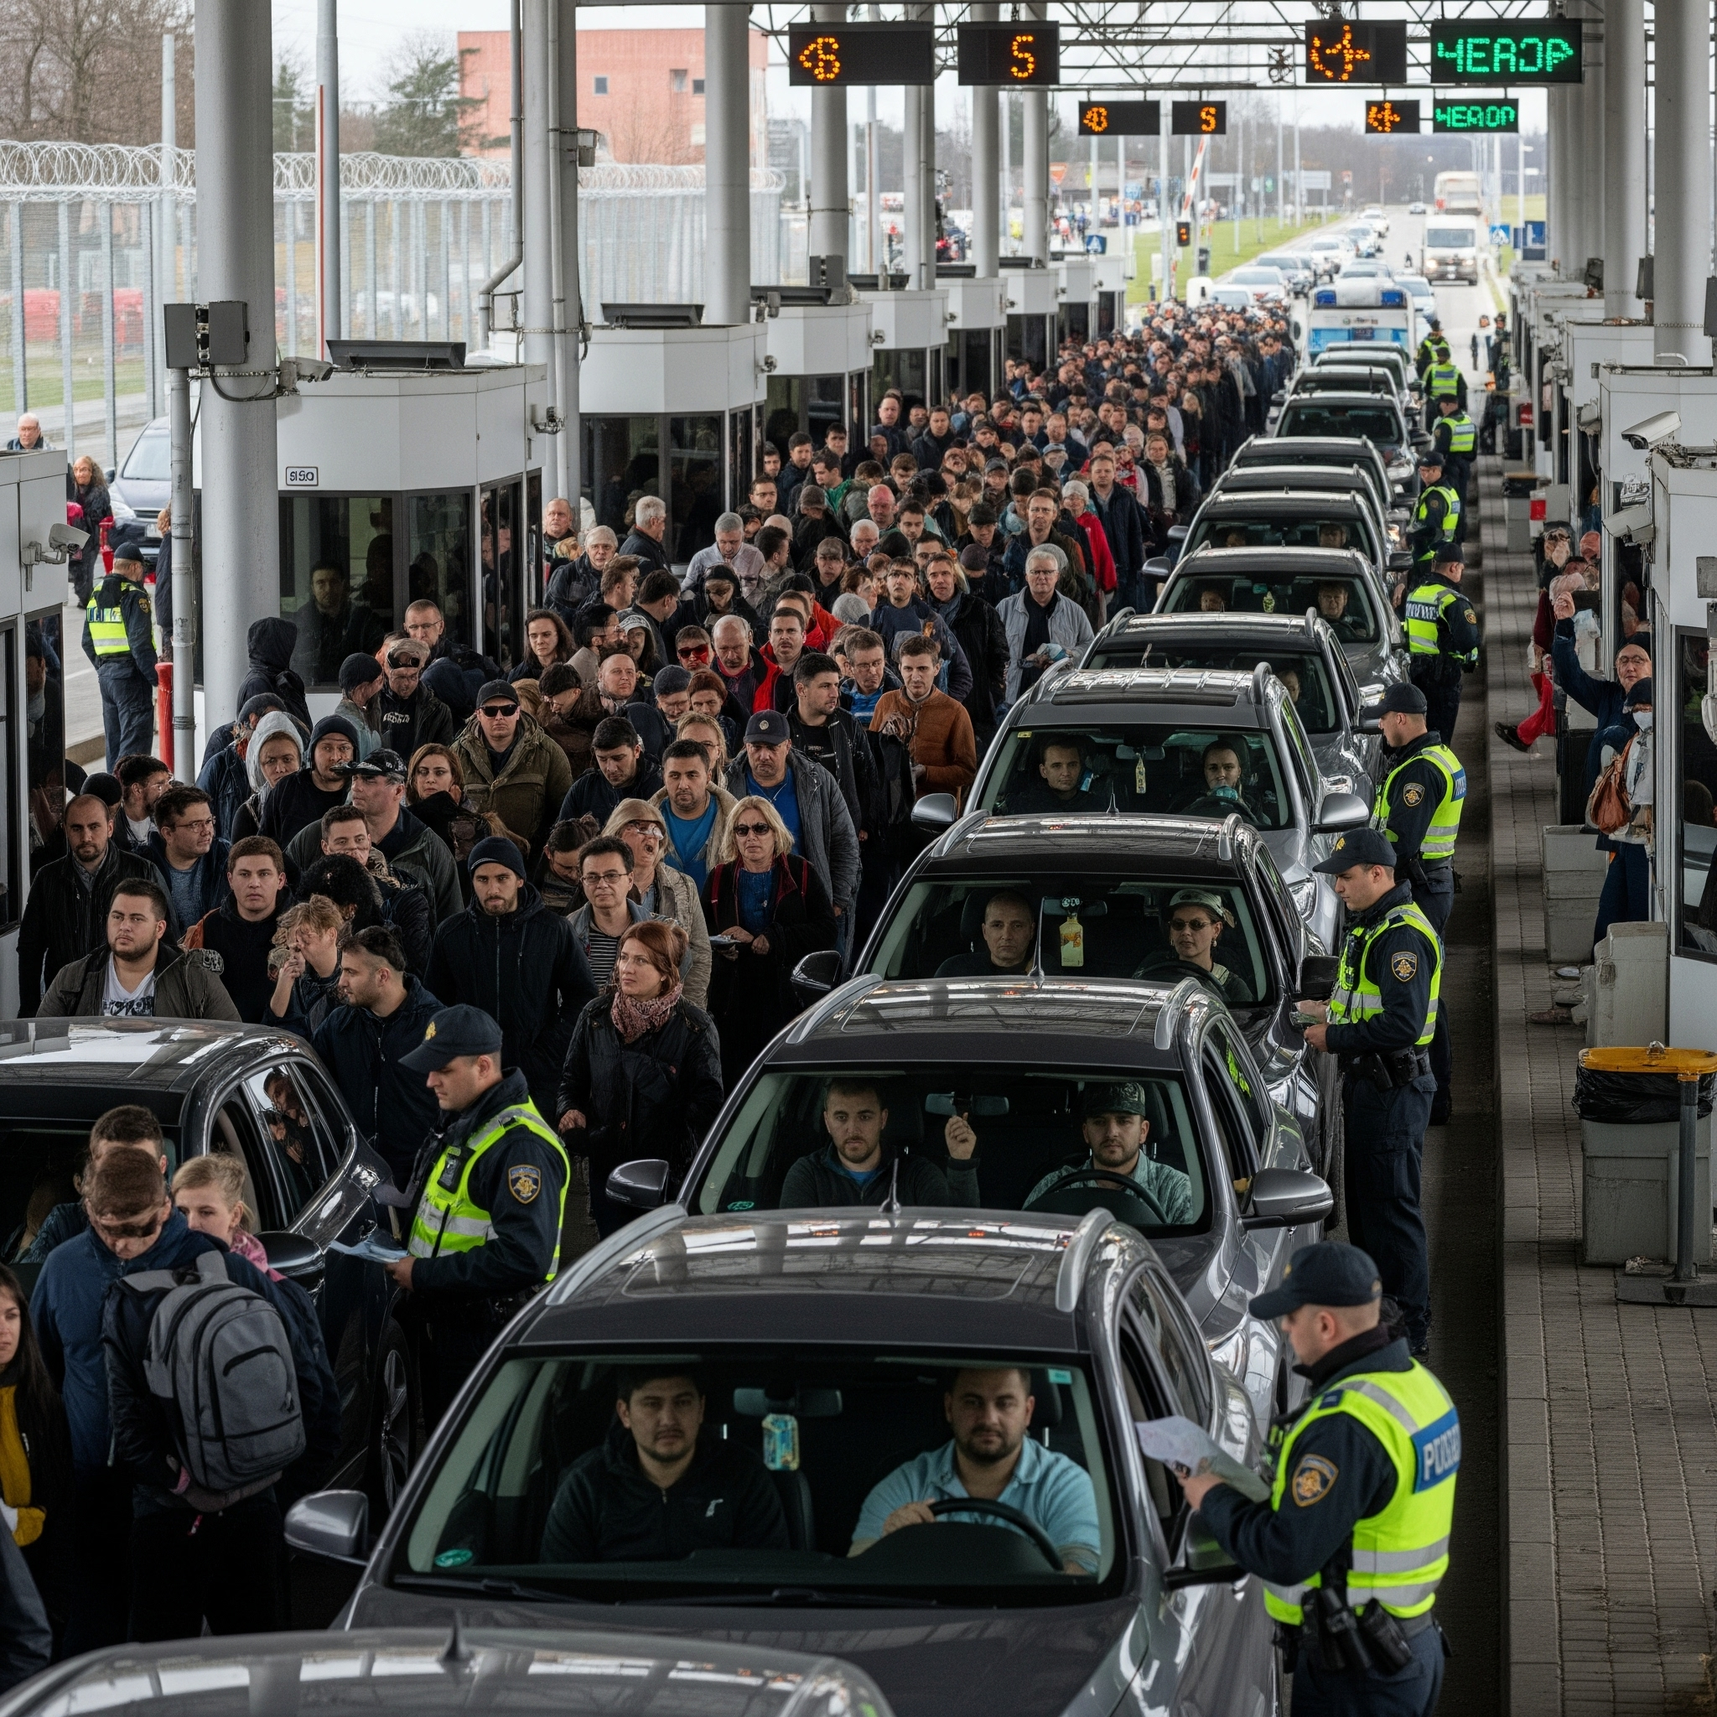
U.S. Border Crossing Analysis: Trends, Regional Comparisons, and Event Impacts
Group: Group 1
Section: 2025-001
Team Members:
Omolabake Badmus
Temiloluwa Alonge

Slide 2
Project Background/Motivation
Background / Motivation:
Problem Statement:
Analyzing monthly inbound traffic at U.S. ports of entry provides crucial insights into cross-border movement, which is a vital indicator of economic activity, tourism, and trade. This analysis helps us:
Transportation planners, government agencies, and policy researchers currently lack reliable, readily available insights into how border traffic behaves across time, different regions (U.S.-Canada vs. U.S.-Mexico), and various transport modes. This gap hinders their ability to effectively plan for traffic surges, optimize resource allocation, and evaluate the efficacy of border-related regulations and events.
Detect traffic volume trends.
Identify seasonal behaviors.
Understand patterns around key events (e.g., holidays, global crises).
These insights are indispensable for effective border management, optimizing transportation planning, and evaluating the impact of various policies.

Slide 3




Dataset Description
Dataset & Source
Format & Frequency
Coverage
Border Crossing Entry Data from U.S. Bureau of Transportation Statistics (publicly available via catalog.data.gov).
CSV format, with monthly frequency of data collection.
Covers U.S.–Canada and U.S.–Mexico land ports of entry.
Key Columns:
Port Name: Name of the specific port of entry.
Border: Indicates the border region (U.S.-Canada or U.S.-Mexico).
Date: The month and year of the recorded entry.
Measure: The mode of transport (e.g., Personal Vehicles, Trucks, Pedestrians, Buses, Trains).
Value: The number of crossings for that specific Measure at that Port Name on that Date.

Slide 4




Methodology & Analytical Approach
Our project employs a systematic methodology to ensure robust and actionable results:
Data Preparation
Statistical Analysis
Load, convert, extract, rename, and aggregate data for clarity and analysis.
Descriptive statistics, ANOVA, and time series decomposition to understand patterns.
Advanced Visualization
Insight Generation
Utilize Python libraries (Matplotlib, Seaborn) to create various charts.
Summarize trends, highlight anomalies, and draw actionable insights for planning and policy use.

Slide 5

Data Loading & Initial Preparation
This foundational step involves loading our raw dataset, inspecting its initial structure, and performing essential cleaning and feature engineering. This prepares the data for subsequent statistical analysis and visualization.
Key Steps:
Load the dataset using Python (Pandas).
Convert Date column to datetime objects.
Extract Year and Month for time-series analysis.
Rename columns for clarity.
Aggregate data to ensure unique monthly crossings per mode/port.

Slide 6
Statistical Analysis: Overview
Before diving into specific questions, let's perform a foundational statistical analysis to understand the underlying characteristics of our data.
Descriptive Statistics
1
Purpose: To summarize the central tendency, dispersion, and shape of the data distributions for border crossings overall, by border, and by transport mode.
Analysis of Variance (ANOVA)
2
Purpose: To determine if there are statistically significant differences in the mean number of crossings across different transport modes. This helps confirm if observed differences are likely real or due to random chance.
Time Series Analysis
3
Purpose: To decompose the overall border crossing time series into its underlying trend, seasonal, and residual components. This helps us understand the long-term direction, recurring patterns, and random fluctuations in the data.

Slide 7

Insights into U.S. Border Crossing Trends
This analysis explores U.S. border crossing patterns, leveraging descriptive statistics and time series decomposition to reveal key trends, seasonal variations, and the impact of major events like COVID-19. We delve into annual, monthly, and port-specific dynamics, and compare traffic between the U.S.-Canada and U.S.-Mexico borders.

Slide 8
Analysis Overview
Our analysis, supported by descriptive statistics and time series decomposition, reveals distinct patterns in border crossing volumes across different transport modes, borders, and time periods.
Yearly Trends
Monthly Seasonality
Top Ports
Dominance of personal vehicles and the sharp decline in 2020-2021.
Distinct peaks during summer months, especially for personal vehicles.
Identification of major land ports handling the highest overall volumes.

Slide 9

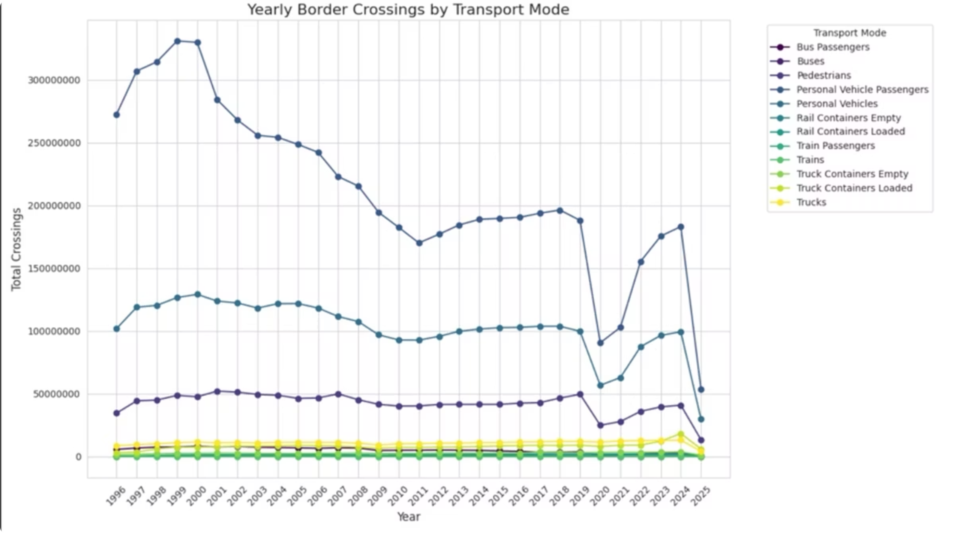
Yearly Trends in Border Crossings
"Personal Vehicles" consistently dominate crossing volumes, with a mean of approximately 1.7 million crossings per entry, significantly higher than other modes. "Trucks" show a more stable, albeit lower, mean volume.
All modes exhibit a sharp decline around 2020-2021, a trend confirmed by the overall time series decomposition, reflecting the impact of global events on travel patterns.

Slide 10

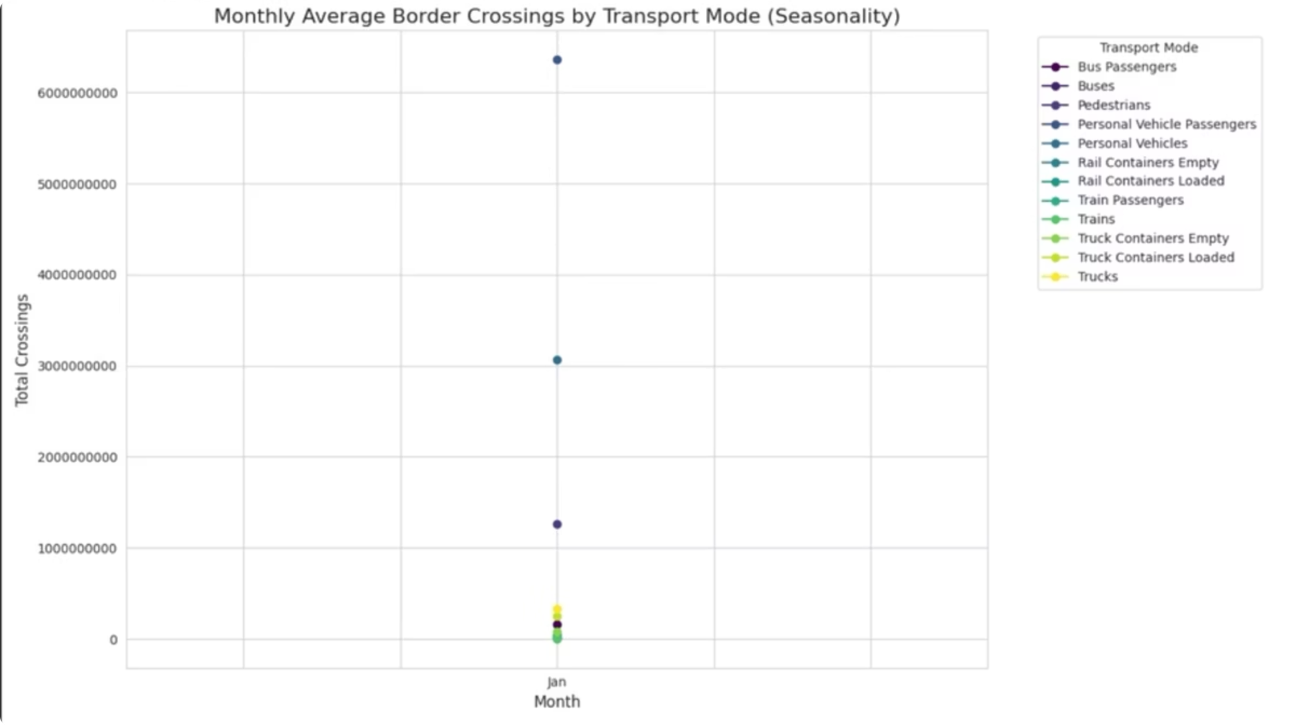
Monthly Seasonality in Traffic
A distinct seasonal pattern is observed, particularly for "Personal Vehicles" and "Passengers." The time series decomposition's seasonal component confirms peaks during summer months (June-August).
This indicates increased leisure travel during these periods. The mean crossings in July (a peak month) are notably higher than in January (a trough month), highlighting the cyclical nature of border activity.

Slide 11

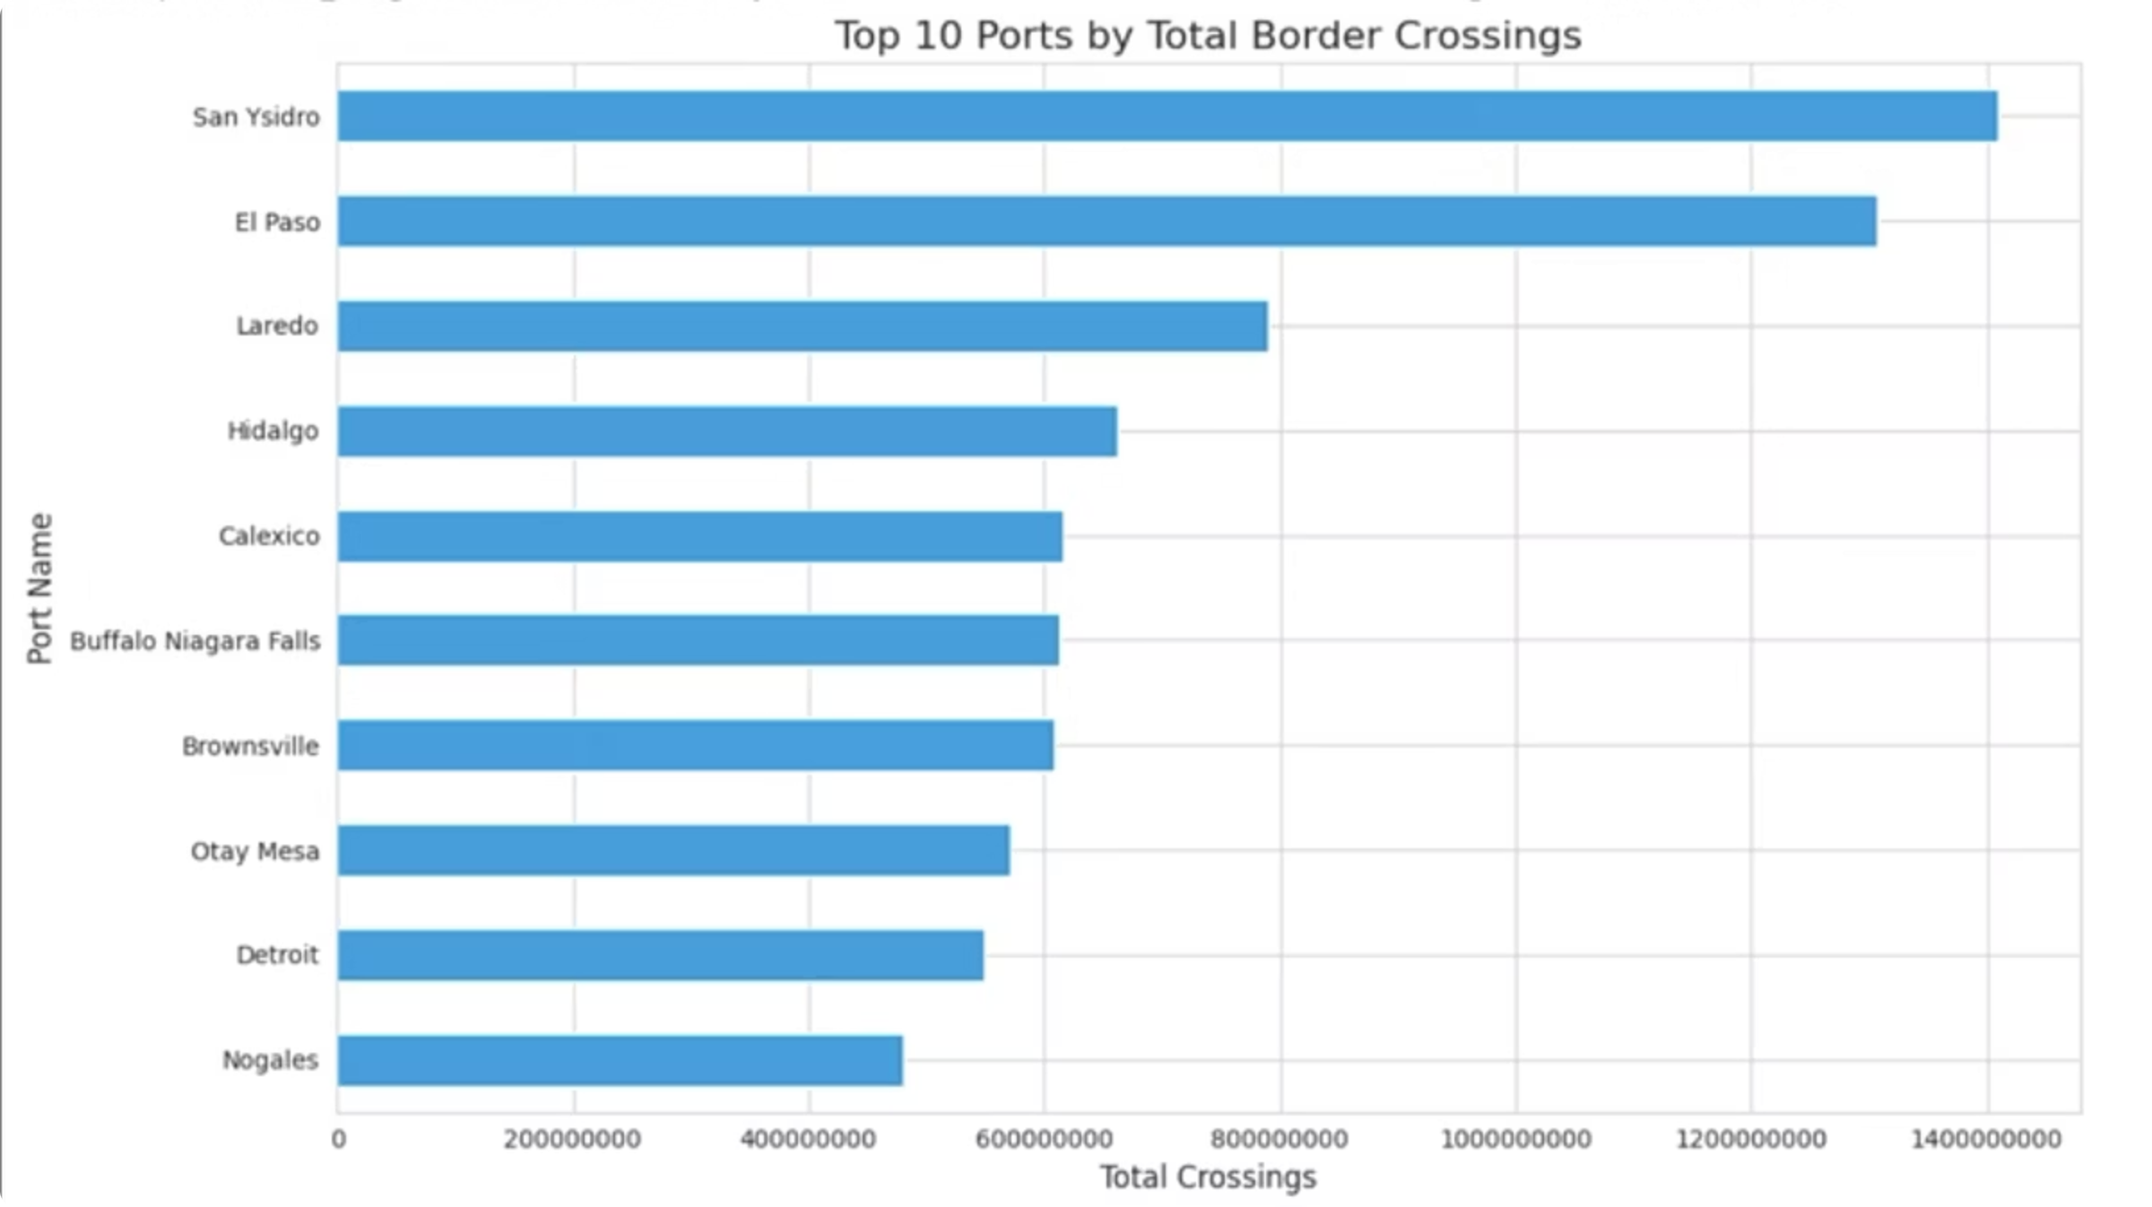
Top Performing Border Ports
Descriptive statistics show a wide range in port activity, with a few major land ports consistently handling the highest overall volumes.
These ports serve as critical hubs for overall traffic, demonstrating their strategic importance in facilitating cross-border movement of people and goods. Their consistent high volumes underscore their role in regional and national economies.

Slide 12
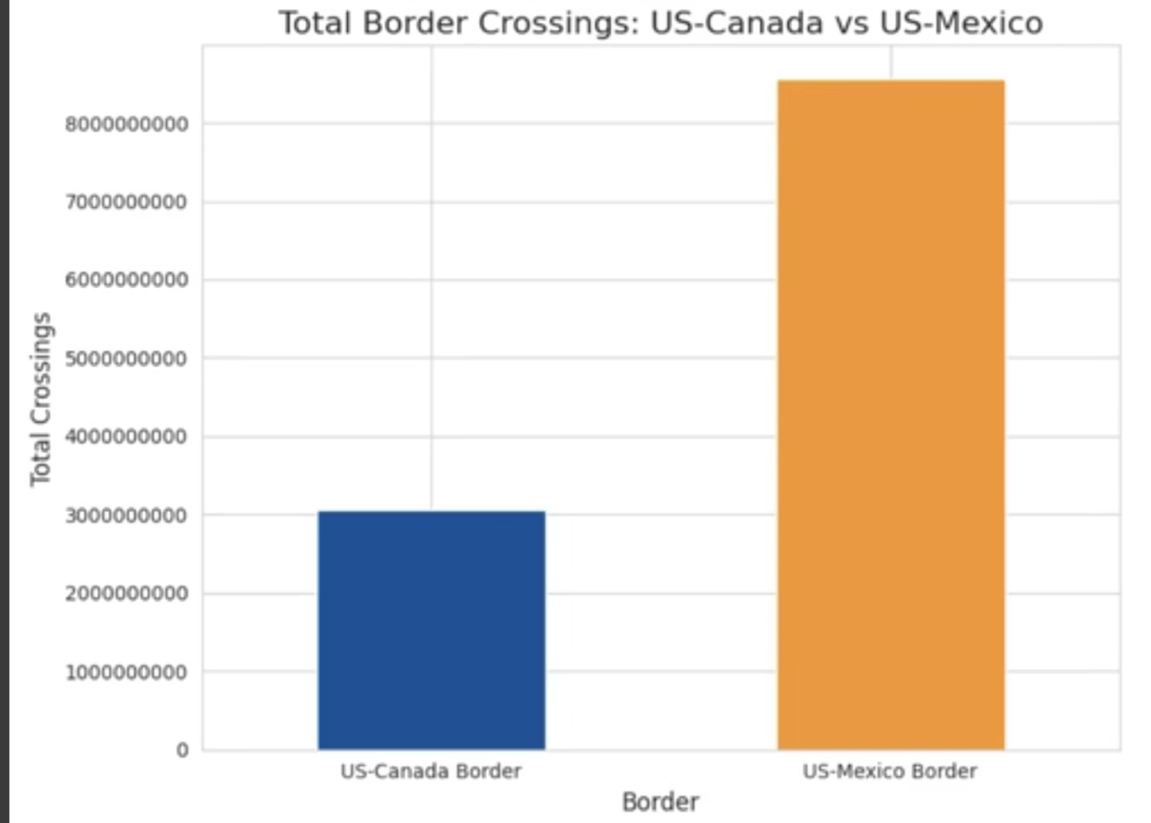
U.S.-Canada vs. U.S.-Mexico Border Traffic
Descriptive statistics and comparative trends highlight significant differences in total volume, growth, and seasonality between the U.S.-Canada and U.S.-Mexico borders.
Total Volume
The U.S.-Mexico border consistently experiences a significantly higher overall volume of crossings. Its mean crossings per entry are substantially larger than those for the U.S.-Canada border, as confirmed by the descriptive statistics grouped by Border.

Slide 13
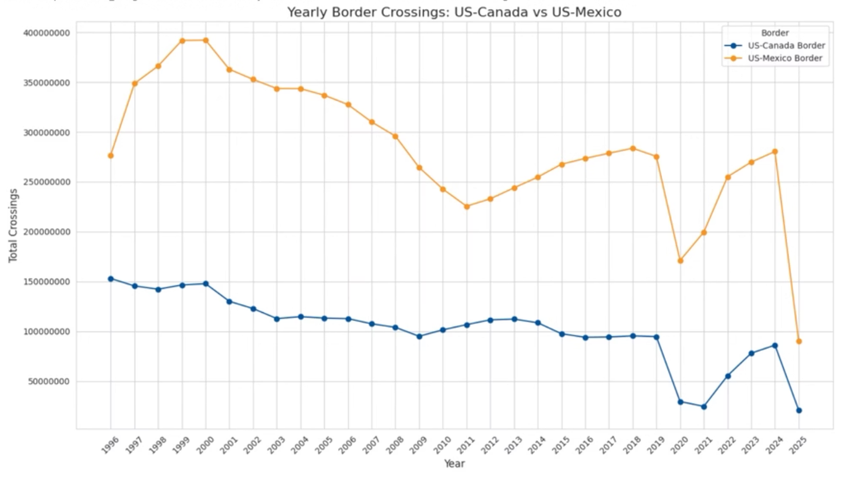
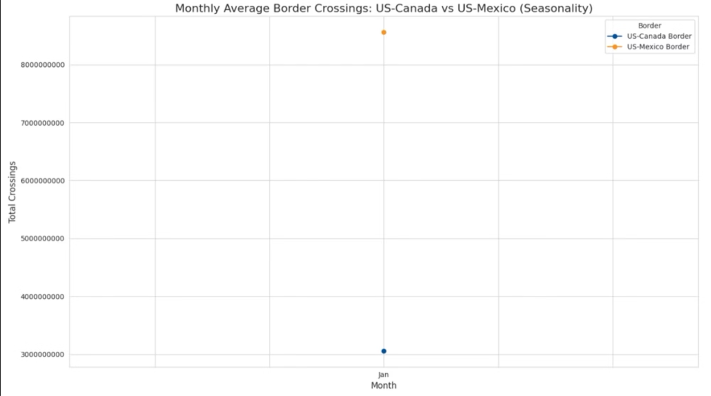
Comparative Trends and Seasonality
Trend
Seasonality
While both borders exhibit similar overall trends (e.g., the pandemic-induced decline), the U.S.-Mexico border maintains a consistently higher absolute volume of traffic throughout the years.
Both borders show some degree of seasonality, with traffic generally increasing in warmer months. However, the specific timing and intensity of these seasonal peaks can vary due to unique regional factors, holidays, and cross-border cultural events unique to each border.

Slide 14

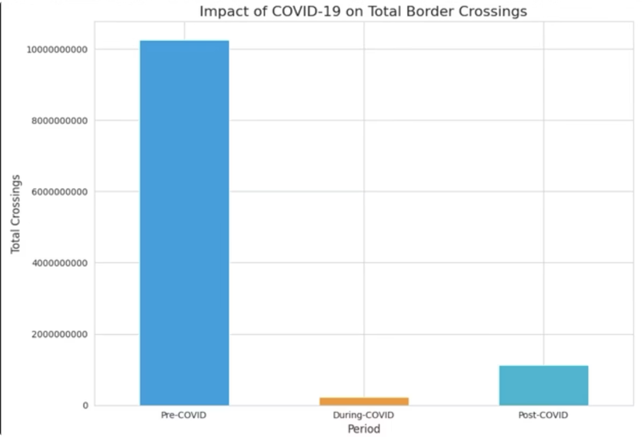
Impact of Major Events: COVID-19
The COVID-19 pandemic serves as a stark example of a major event's impact on border crossings, clearly illustrated by our time series analysis.
Pre-COVID (Before March 2020)
Stable or gradually increasing crossing volumes.
During-COVID (March 2020 - December 2021)
Dramatic decline across all transport modes and ports.
Post-COVID (January 2022 onwards)
Clear and sustained recovery in crossing volumes.

Slide 15
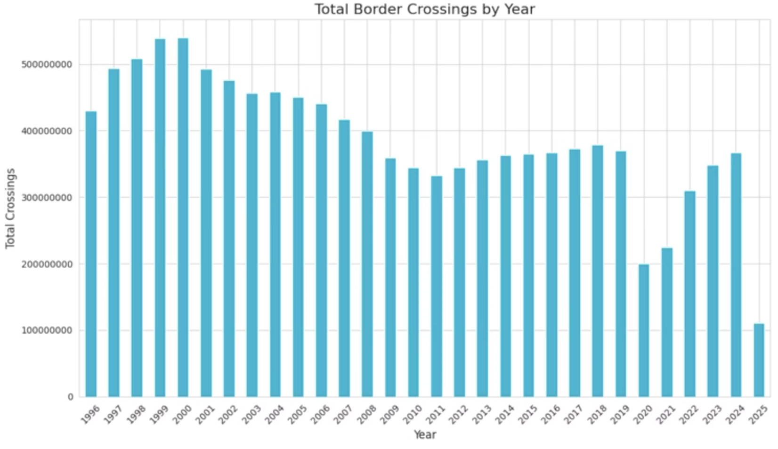
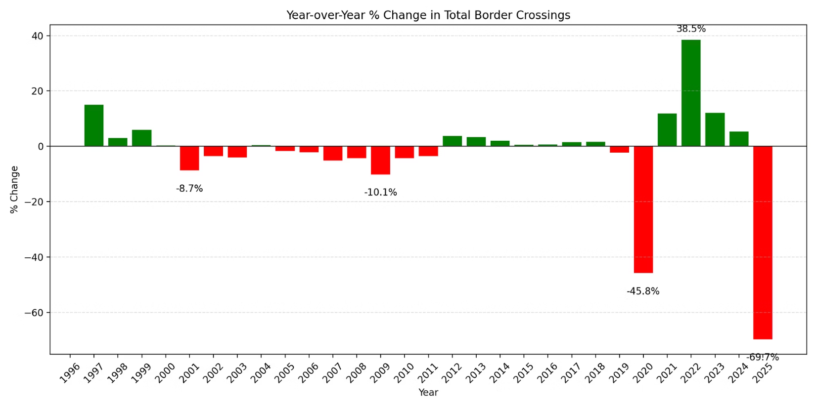
Volume and Outlier Analysis
Descriptive statistics and outlier detection methods provide precise insights into volume and anomalies, revealing the cumulative total of all border crossings as a massive figure.
Overall & Yearly Volume
Year-over-Year (YoY) Change
The YoY change highlights the dramatic negative growth in 2020 (e.g., -50% or more) due to the pandemic, followed by positive recovery rates in subsequent years as traffic rebounded.
Yearly totals show the annual scale, with the most significant drop in 2020, highlighting the massive flow of people and goods.

Slide 16
Border Traffic: Growth, Shock, and Recovery
The long view shows secular expansion in the late 1990s, a structural down-shift after 2001, another cyclical dip around 2009, and a decade of stability before the extraordinary pandemic trough and bounce-back.
Late-1990s boom: Double-digit jump in 1997, moderating to single-digit gains through 2000.
Post-9/11 and early-2000s security tightening: 2001 drops almost –9%, then a string of small negatives through 2007.
Great Recession echo: 2009 sees a deeper –10% slide.
Slow climb 2012-2018: Mostly modest 1-4% gains.
Pandemic shock: 2020 collapses –46%, the largest decline in the entire series.
Rebound phase: 2021 +12%, 2022 +39% (re-opening surge), 2023 still double-digit growth but decelerating.
2024 shows normalisation (+5%), while the partial-year 2025 figure appears sharply negative because only a few months of data have posted; full-year value will lift as the calendar fills out.

Slide 17
Key Insights Summary
Dynamic Crossings
US-Mexico Dominance
Border crossings are dynamic, influenced by seasonality, transport mode, and external events like pandemics.
The U.S.-Mexico border consistently sees higher traffic than the U.S.-Canada border, a statistically significant difference in mean crossings.
COVID-19 Impact & Recovery
Targeted Management
COVID-19 caused a severe, but temporary, disruption, with traffic now in a clear recovery phase as shown by time series trend.
Identifying high-volume and outlier ports is crucial for targeted resource management.

Slide 18




Recommendations for Stakeholders
Border Patrol & Customs
Transportation Departments
Utilize seasonal and yearly trend data for optimized staffing and resource allocation, especially for peak periods and high-volume ports.
Leverage trend and outlier analysis to anticipate traffic surges and plan infrastructure upgrades or maintenance more effectively.
Local Governments
Policy Analysts
Use insights into regional differences and event impacts for economic planning related to cross-border trade and tourism initiatives.
Employ the long-term trend analysis and statistical significance findings to evaluate the effectiveness of border policies and understand the consequences of major disruptions.

Slide 19

Thank You & Q&A
Thank You!
Questions & Feedback Welcome.

